Slide 1

Student Management System
An OOPs Project in Java
Group Name: Fantastic Four
Team Members Name:
Virat(Team Leader)
Yash mishra
pankaj kumar
chetan

Slide 2
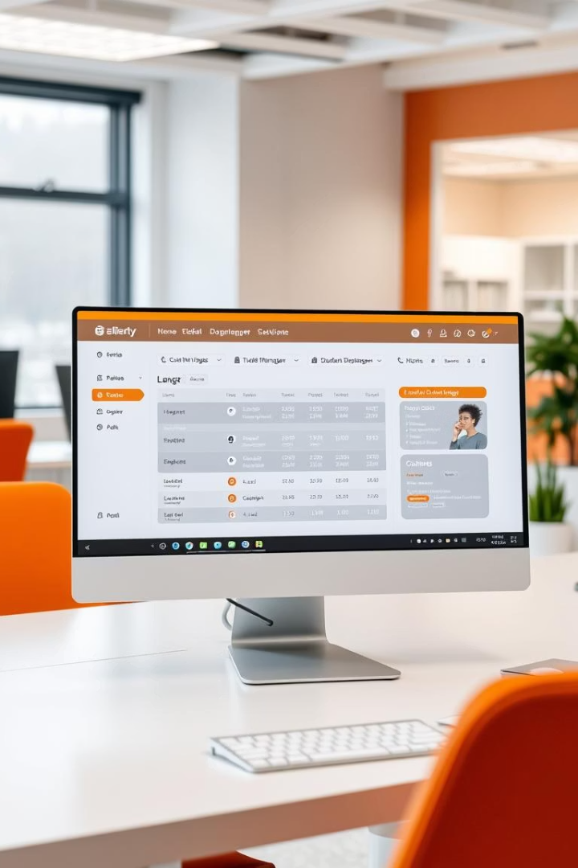
Project Overview
What is It?
OOP Concepts
Java app to manage student records efficiently.
Uses encapsulation, inheritance, polymorphism, abstraction.
Key Features
Add, view, update, delete students; handle graduate and regular types.

Slide 3
OOP Concepts Used
1
Encapsulation
2
Inheritance
3
Polymorphism
Private fields with getters/setters
GraduateStudent extends Student
Overrides toString() method
4
Abstraction
5
Association
Interfaces for database and UI
App uses StudentDatabase and UserInterface

Slide 4
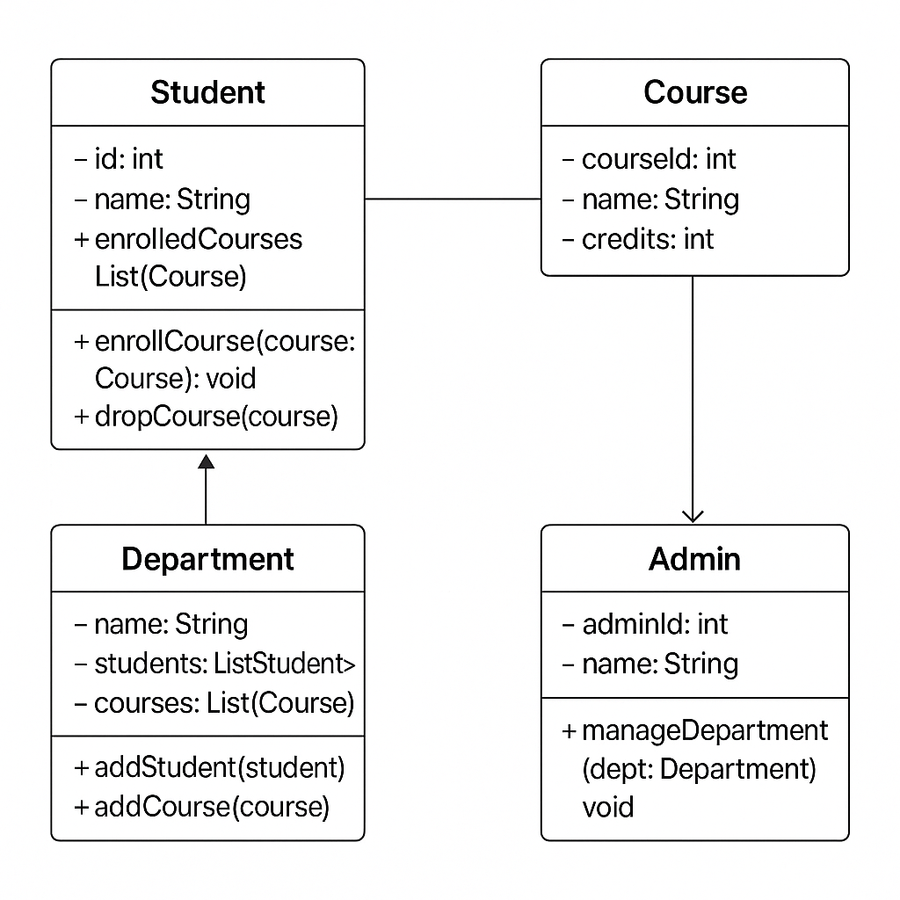
Class Diagram
Student base class with id, name, age, department.
GraduateStudent adds thesisTitle and advisor fields.

Slide 5
Key Classes & Roles
Student
GraduateStudent
StudentDatabase
InMemoryStudentDatabase
Base class with student details
Inherits Student, adds thesis info
Interface for CRUD operations
Implements database in memory
UserInterface
ConsoleUI
Application
Defines UI methods
Console-based UI implementation
Main controller class

Slide 6
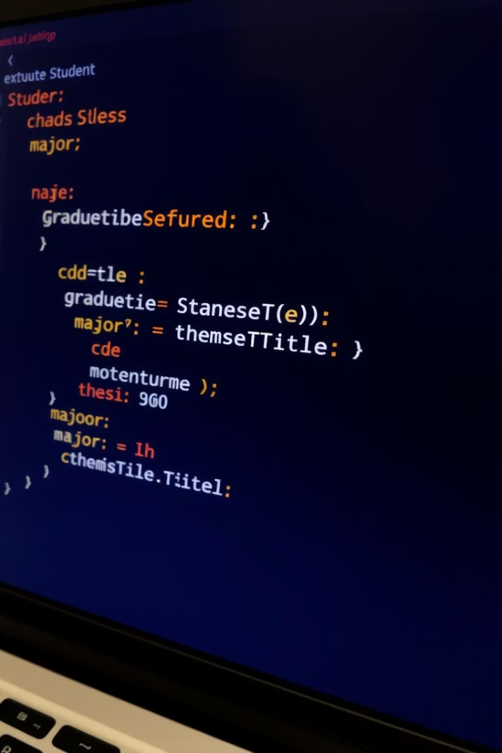


Inheritance & Polymorphism
Inheritance
GraduateStudent inherits all Student properties
Polymorphism
Overrides toString() for custom display

Slide 7
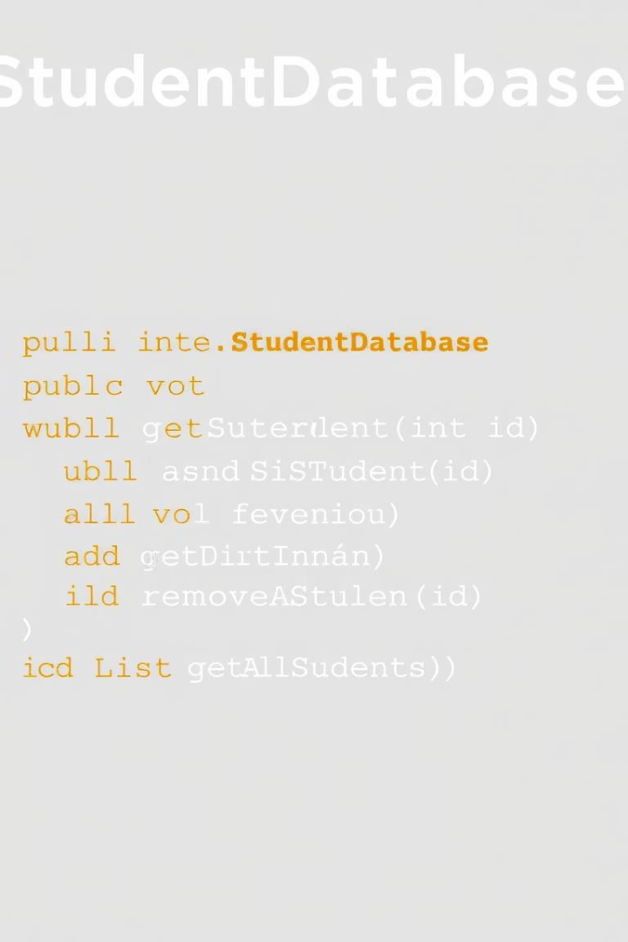
Abstraction with Interfaces
Abstraction
Defines what operations are needed, not how
Implementation
InMemoryStudentDatabase handles data storage

Slide 8
Features & Functionality
Add Students (Regular & Graduate)
View Student Details
Update Student Records
Delete Students
List All Students

Slide 9
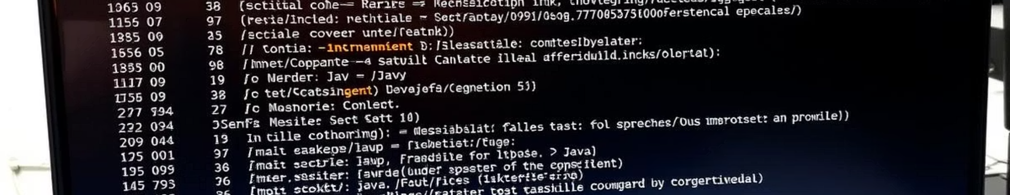
How to Run the Project
1
Compile
2
Run
3
Interface
javac *.java
java StudentManagementSystem
Use menu-driven console interface

Slide 10

Future Enhancements
Persistence
Save data to a file
Search & Sorting
Add search and sorting features
GUI
Implement JavaFX or Swing interface
Validation
Add input validation

Slide 11
Thank you

